Slide 1
COVID 19 Analysis
Neeraj Negi

Slide 2
Summary context
Context
Coronaviruses are a large family of viruses which may cause illness in animals or humans. In humans, several coronaviruses are known to cause respiratory infections ranging from the common cold to more severe diseases such as Middle East Respiratory Syndrome (MERS) and Severe Acute Respiratory Syndrome (SARS). The most recently discovered coronavirus causes coronavirus disease COVID-19 - World Health Organization
The number of new cases are increasing day by day around the world. This dataset has information from the states and union territories of India at daily level.
State level data comes from Ministry of Health & Family Welfare
Testing data and vaccination data comes from covid19india.

Slide 3
Resource, aIm and audience
Our data contains three datasets which includes Covid 19 India, Statewise Vaccine data and Testing Details
AIM is to analysis the state wise data for all the available data and find out how each state has respond to the pandemic
AUDIENCE: we are preparing this analysis for Central/State governments and medical infrastructure boards to prepare each state to tackle the 3rd wave or future medical emergency

Slide 4
State wise covid sample comparison
Uttar Pradesh, Bihar and Tamil Nadu has the high number of covid collection but turnround time of covid result seems to be vary slow
Jharkhand, J&K and Andhra Pradesh seems to have better testing facility as they have higher sampler collection and test results

Slide 5
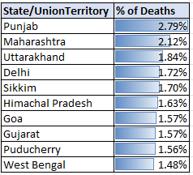
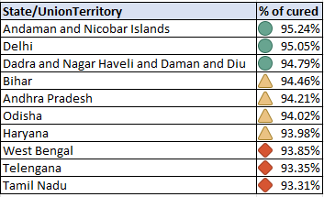
Top 10 state ranking in % of Death and cured
% of Death Top 10 States
% of Cured Top 10 States

Slide 6
MONTH WISE GENDER VACCIATION

Slide 7
Vaccine consumption
CoviShield is the highly used vaccine out of all three available vaccine
Top-10 highest CoviShield consuming state

Slide 8
Sample comparison

